Slide 1

Happy People
Anna Brown, Josh Chung, Kim McKeever, Alex Snyder

Slide 2
Core Idea: Analysis of employee reviews within the “Big 5”.
Which of the subcategories impacted the overall rating the most?
Reason: In order to find which factor effected the overall rating the most?
Result: Culture had the biggest impact.
Are there were any common themes in what people like about their jobs?
Reason: What do people like and dislike about their jobs based on written reviews?
Result: Management, Work-Life Balance, and benefits are common themes.
Do unemployment rates have an impact on overall job ratings?
Reason: Are people happier with their jobs when more people are unemployed?
Result: Yes, people rate their jobs more poorly when unemployment rates are high.
Does company success have an impact on employee satisfaction?
Reason: do successful companies attract (or create) happier employees?
Result: There is no impact of company success on employee satisfaction.

Slide 3
Which of the subcategories impacted the overall rating the most?

Slide 4
To what extent do these factors impact an employee's overall opinion of a company?
Opportunities, Work- Life Balance, Management, Culture
Cleaning
Data Frame
Drop NA
Convert to float
scikit-learn vs. SciPy

Slide 5
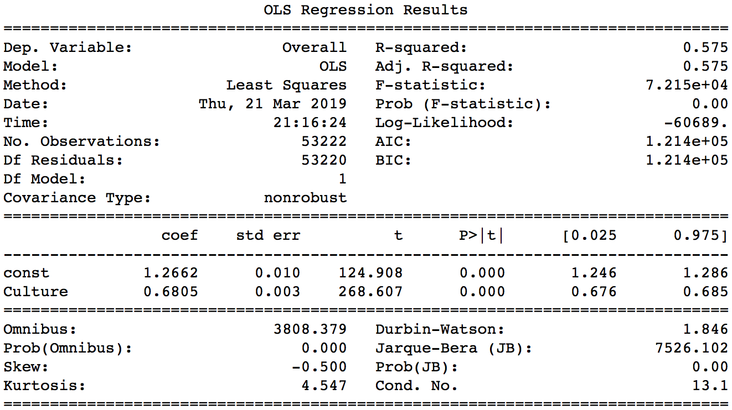
Single Variable Linear Regression (Culture)

Slide 6
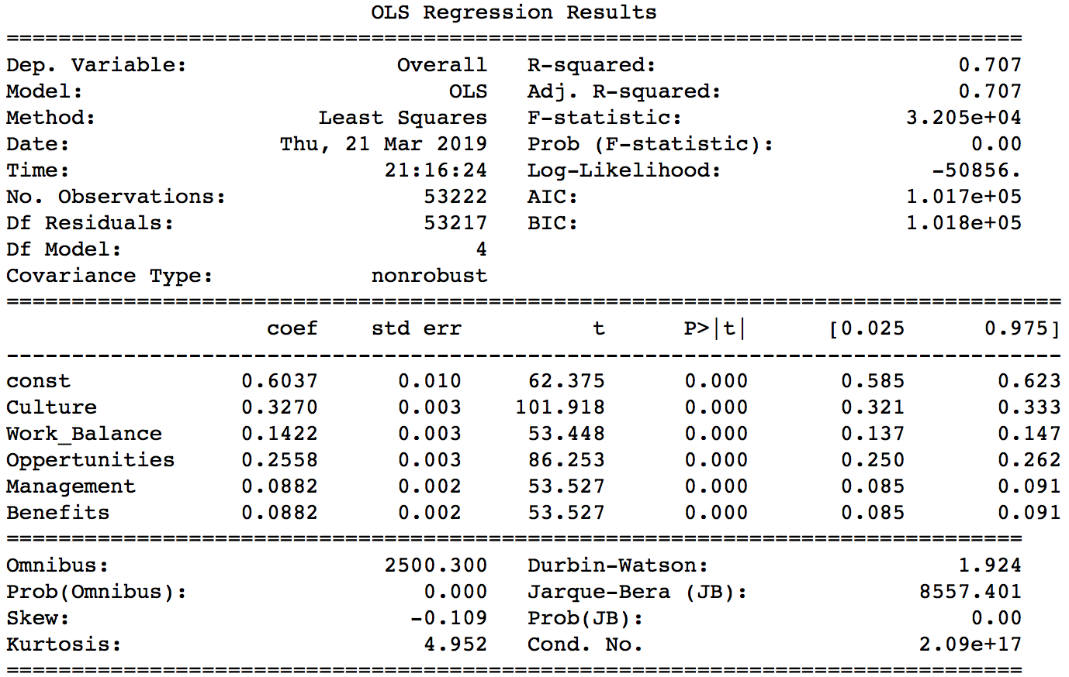
Multiple Variable Linear Regression (Culture, Work-Life Balance, Opportunities, Management, Benefits)

Slide 7
Other Considerations:
Limitations:
Self selection
Ratings are subjective
Other factors
Further Research:
Additional factors/ variables
Random sample
Group by company

Slide 8
Are there were any common themes in what people like about their jobs?

Slide 9
Question:
What do people like about their jobs?
What do people dislike about their jobs?
Data Cleanup, Exploration, and Analysis
Started by taking all data from the pros column, turning each entry into a tokenized list and used a counter object to count how many tokens were in each list. Added together counters.
Functional but VERY INEFFICIENT (10+ minutes).
Took the data from each cell and placed it all into a text file.
Used Natural Language Toolkit (NLTK) library to tokenize and count text file.
Much much faster (~10 sec)
Used loc to separate by company and created individual text files for each company’s pros and cons.
Separated and tokenized each text file.

Slide 10
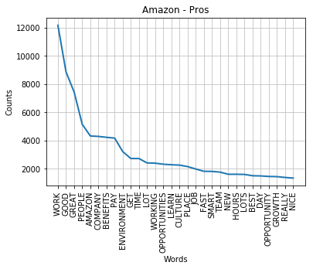
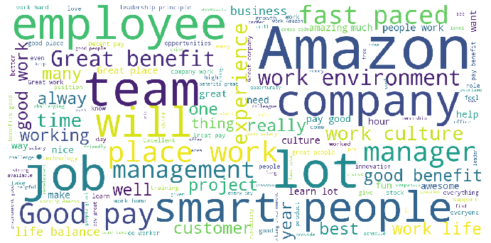
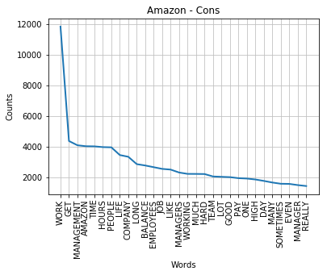
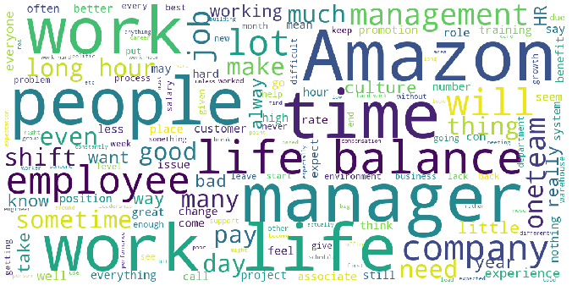

Slide 11
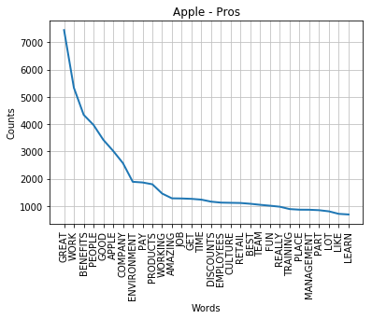

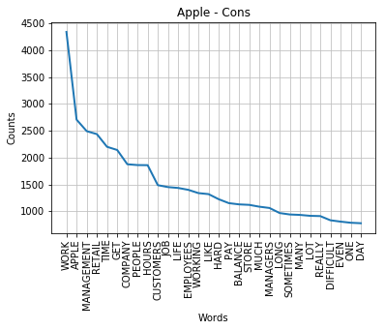
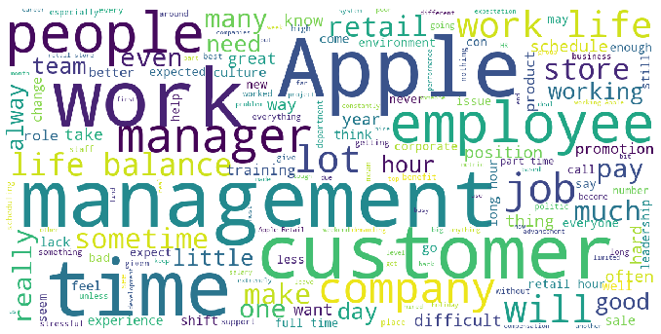

Slide 12
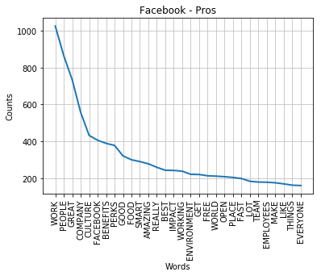
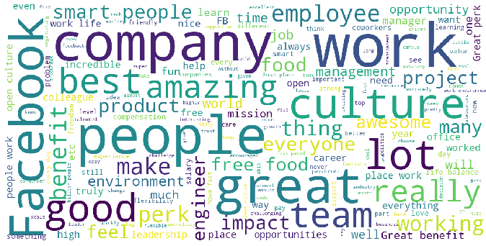
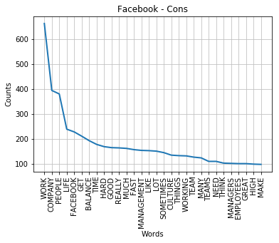
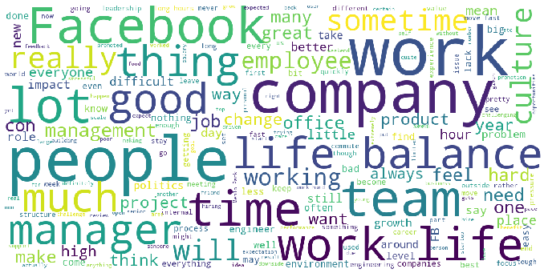

Slide 13
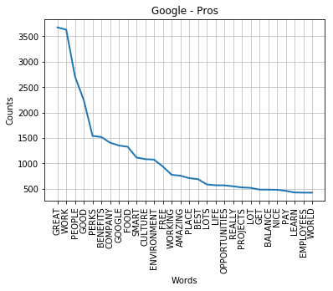
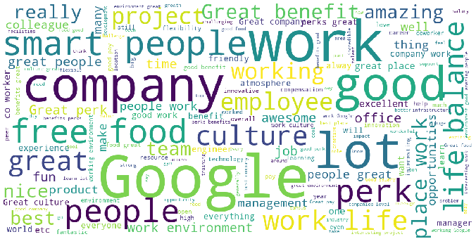
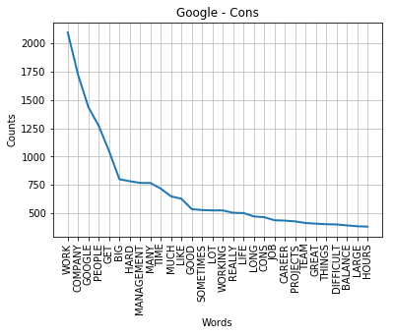
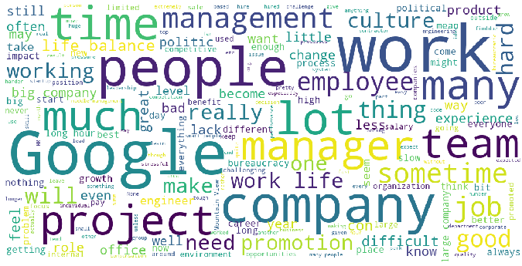

Slide 14
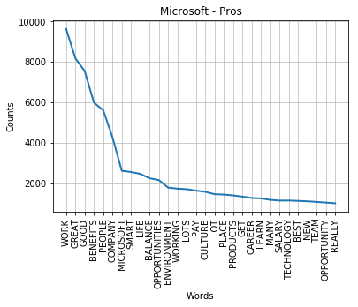

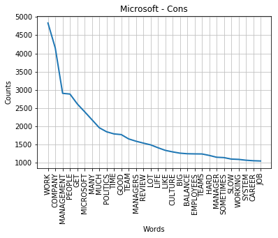
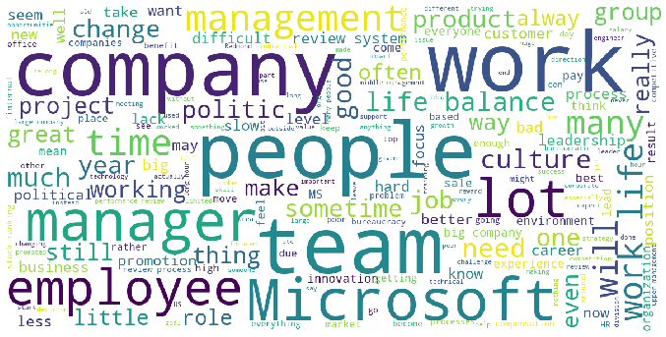

Slide 15
Post Mortem
Complications of language processing.
A lot of human language processing is implicit.
Computers and code are explicit to a fault. The language will be processed exactly as you spec the code.
I wish I had time for:
Language processing in context
Language processing of root words
Language processing of positive and negative affects

Slide 16
Do unemployment rates have an impact on overall job ratings?

Slide 17
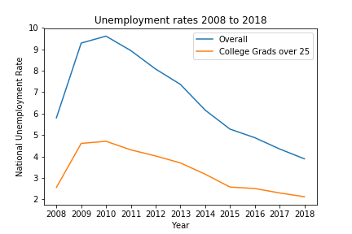
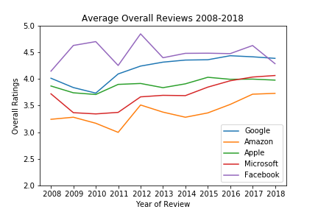
Unemployment and Job Reviews
Data Cleanup & Exploration
Originally planned to use API from Bureau of Labor Statistics however there were issues.
Made minor improvements to spreadsheet.

Slide 18
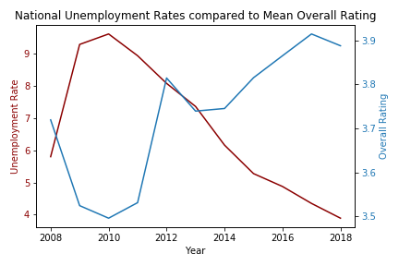
Data Analysis
After reviewing the individual graphs, I combined them to compare the overall rating to the overall national unemployment rate
Notes:
Numbers=facebook in particular

Slide 19
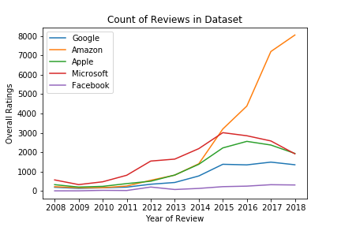
Discussion
Limitations
Glassdoor started in mid-2007 and was therefore less well-known during the “Great Recession” As a result, numbers were low.
People who unhappy or very happy with an experience are most likely to seek out review services.
An increase in focus on Glassdoor reviews could lead happy employees to want to increase their overall ratings
Based on the graph below, it would appear that unemployment does majorly affect overall job ratings.

Slide 20
Post Mortem
Difficulties:
Unusual values in the dataset
BLS API
Further Questions:
Former vs. Current Employees (especially around times of high unemployment)
More companies around 2009-2010
Different review sites.

Slide 21
Does company success have an impact on employee satisfaction?

Slide 22
Is company success an indicator of employee satisfaction?
Stock values were used as an indicator of how well a company was preforming
Historical stock values were retrieved from https://www.worldtradingdata.com/
Employee satisfaction was represented through the overall rating they gave the company when posting a review on Glassdoor.

Slide 23
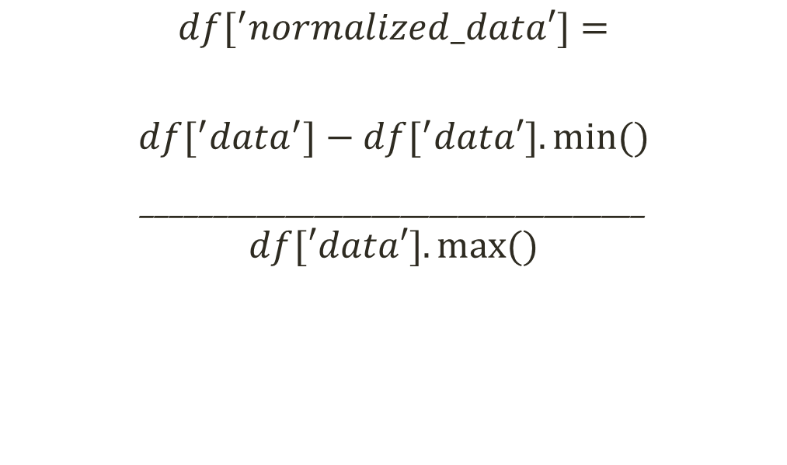
Data manipulation
The dates of reviews from Glassdoor were converted from strings to datetime objects
These dates that reviews were posted were then used to acquire the end of day value for a company’s stock
End of day values for a company’s stock was paired to the date that reviews were posted onto Glassdoor
Allows the comparison of very different scales by putting them in the same range
$$df[^{′}normalized_data′]=$$
$$df[^{′}data^{′}]−df[^{′}data′].min⁡()$$
___________________________________
$$df[′data′].max⁡()$$

Slide 24
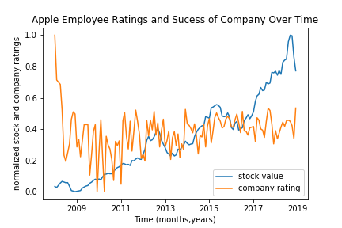
No correlation
Most easily seen when looking at how the comparison of ratings and company success for Apple
Would expect employee ratings to mirror trends in stock if this could be used as an indicator

Slide 25
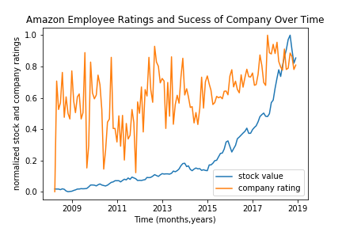
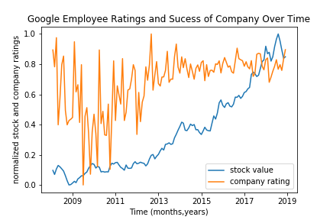
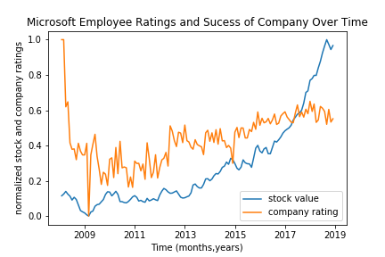
Trends for Amazon, Google, and Microsoft

Slide 26
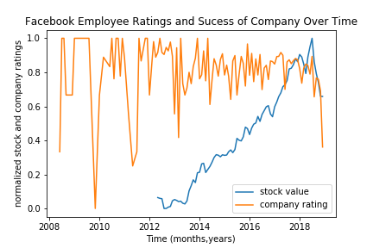
Indications for future studies
The graph for Facebook had indications of employee reviews being affected by the success of the company, marked by the downturn of both in 2018
This was around the time some of the big Facebook scandals started
Other ways of measuring company success?
Customer satisfaction
Attraction of new customers
Independent analysis of earning reports instead of analysis using stock representation

